Slide 1
Head Lice

Slide 2
Selinsgrove School District
Following recommendations from the American Academy of Pediatrics, our district does not have a “No Nit Policy”
Your child doesn’t have to miss school days
They should be treated at home and continue going to school as normal
The school nurse can recheck them at school to make sure treatment is effective if you wish

Slide 3
Here’s the Facts
Head lice is a parasitic insect
They feed on human blood and live close to the scalp
They do not spread disease
About 6 million to 12 million people in the US get head lice each year
Most common in ages 3-11

Slide 4
More Facts
Being spread through objects (clothing, hats, scarves, combs, brushes, towels) is NOT common
Being clean/dirty has nothing to do with getting head lice
Head lice can only crawl… they CANNOT hop, jump, or fly
Head lice is typically spread by direct head-to-head contact

Slide 5
Myths | Facts
It is easy to get lice Lice are dirty and spread disease Lice can survive off people and on furniture, clothing, or sheets for many days Lice eggs can fall off a person’s head, hatch, and give another person lice | Lice is spread through direct head-to-head contact Lice do not spread disease or reflect hygiene Lice need blood and human scalp to survive and will die within 24-36 hours off scalp. Eggs are glued like cement to the scalp and need the scalp to survive

Slide 6
Myths | Facts
Cutting the hair will prevent lice You can get lice from sitting next to someone Lice is commonly spread in school Lice is spread through helmets and hats | The length of the hair does not matter Lice cannot jump, hop, or fly It is more common to get it from household members, not at school The most common transmission is direct head-to-head contact

Slide 7
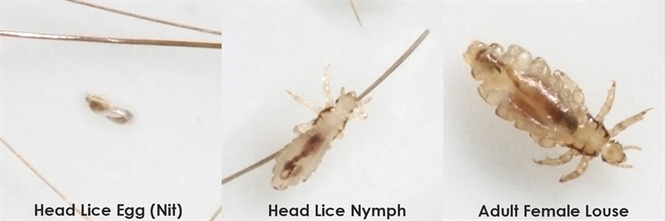
What does it look like?
Three forms: the egg (nit), the nymph, the adult

Slide 8
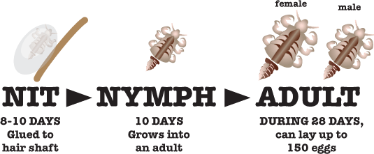

Slide 9
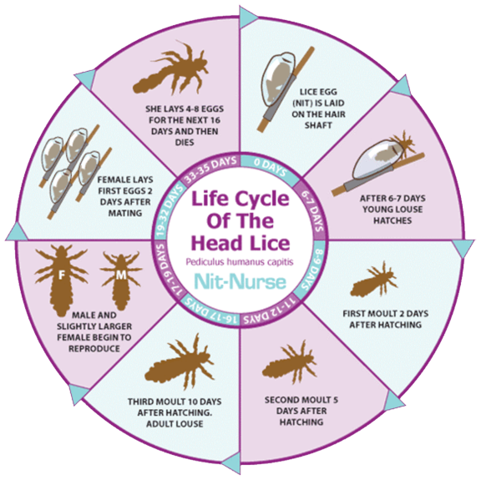

Slide 10
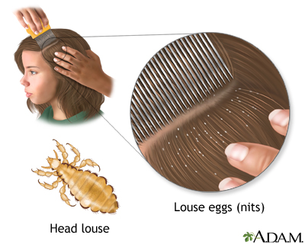
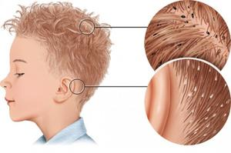
Where Should You Look?
Most commonly found on scalp
Behind the ears
Neckline at the back of the head

Slide 11
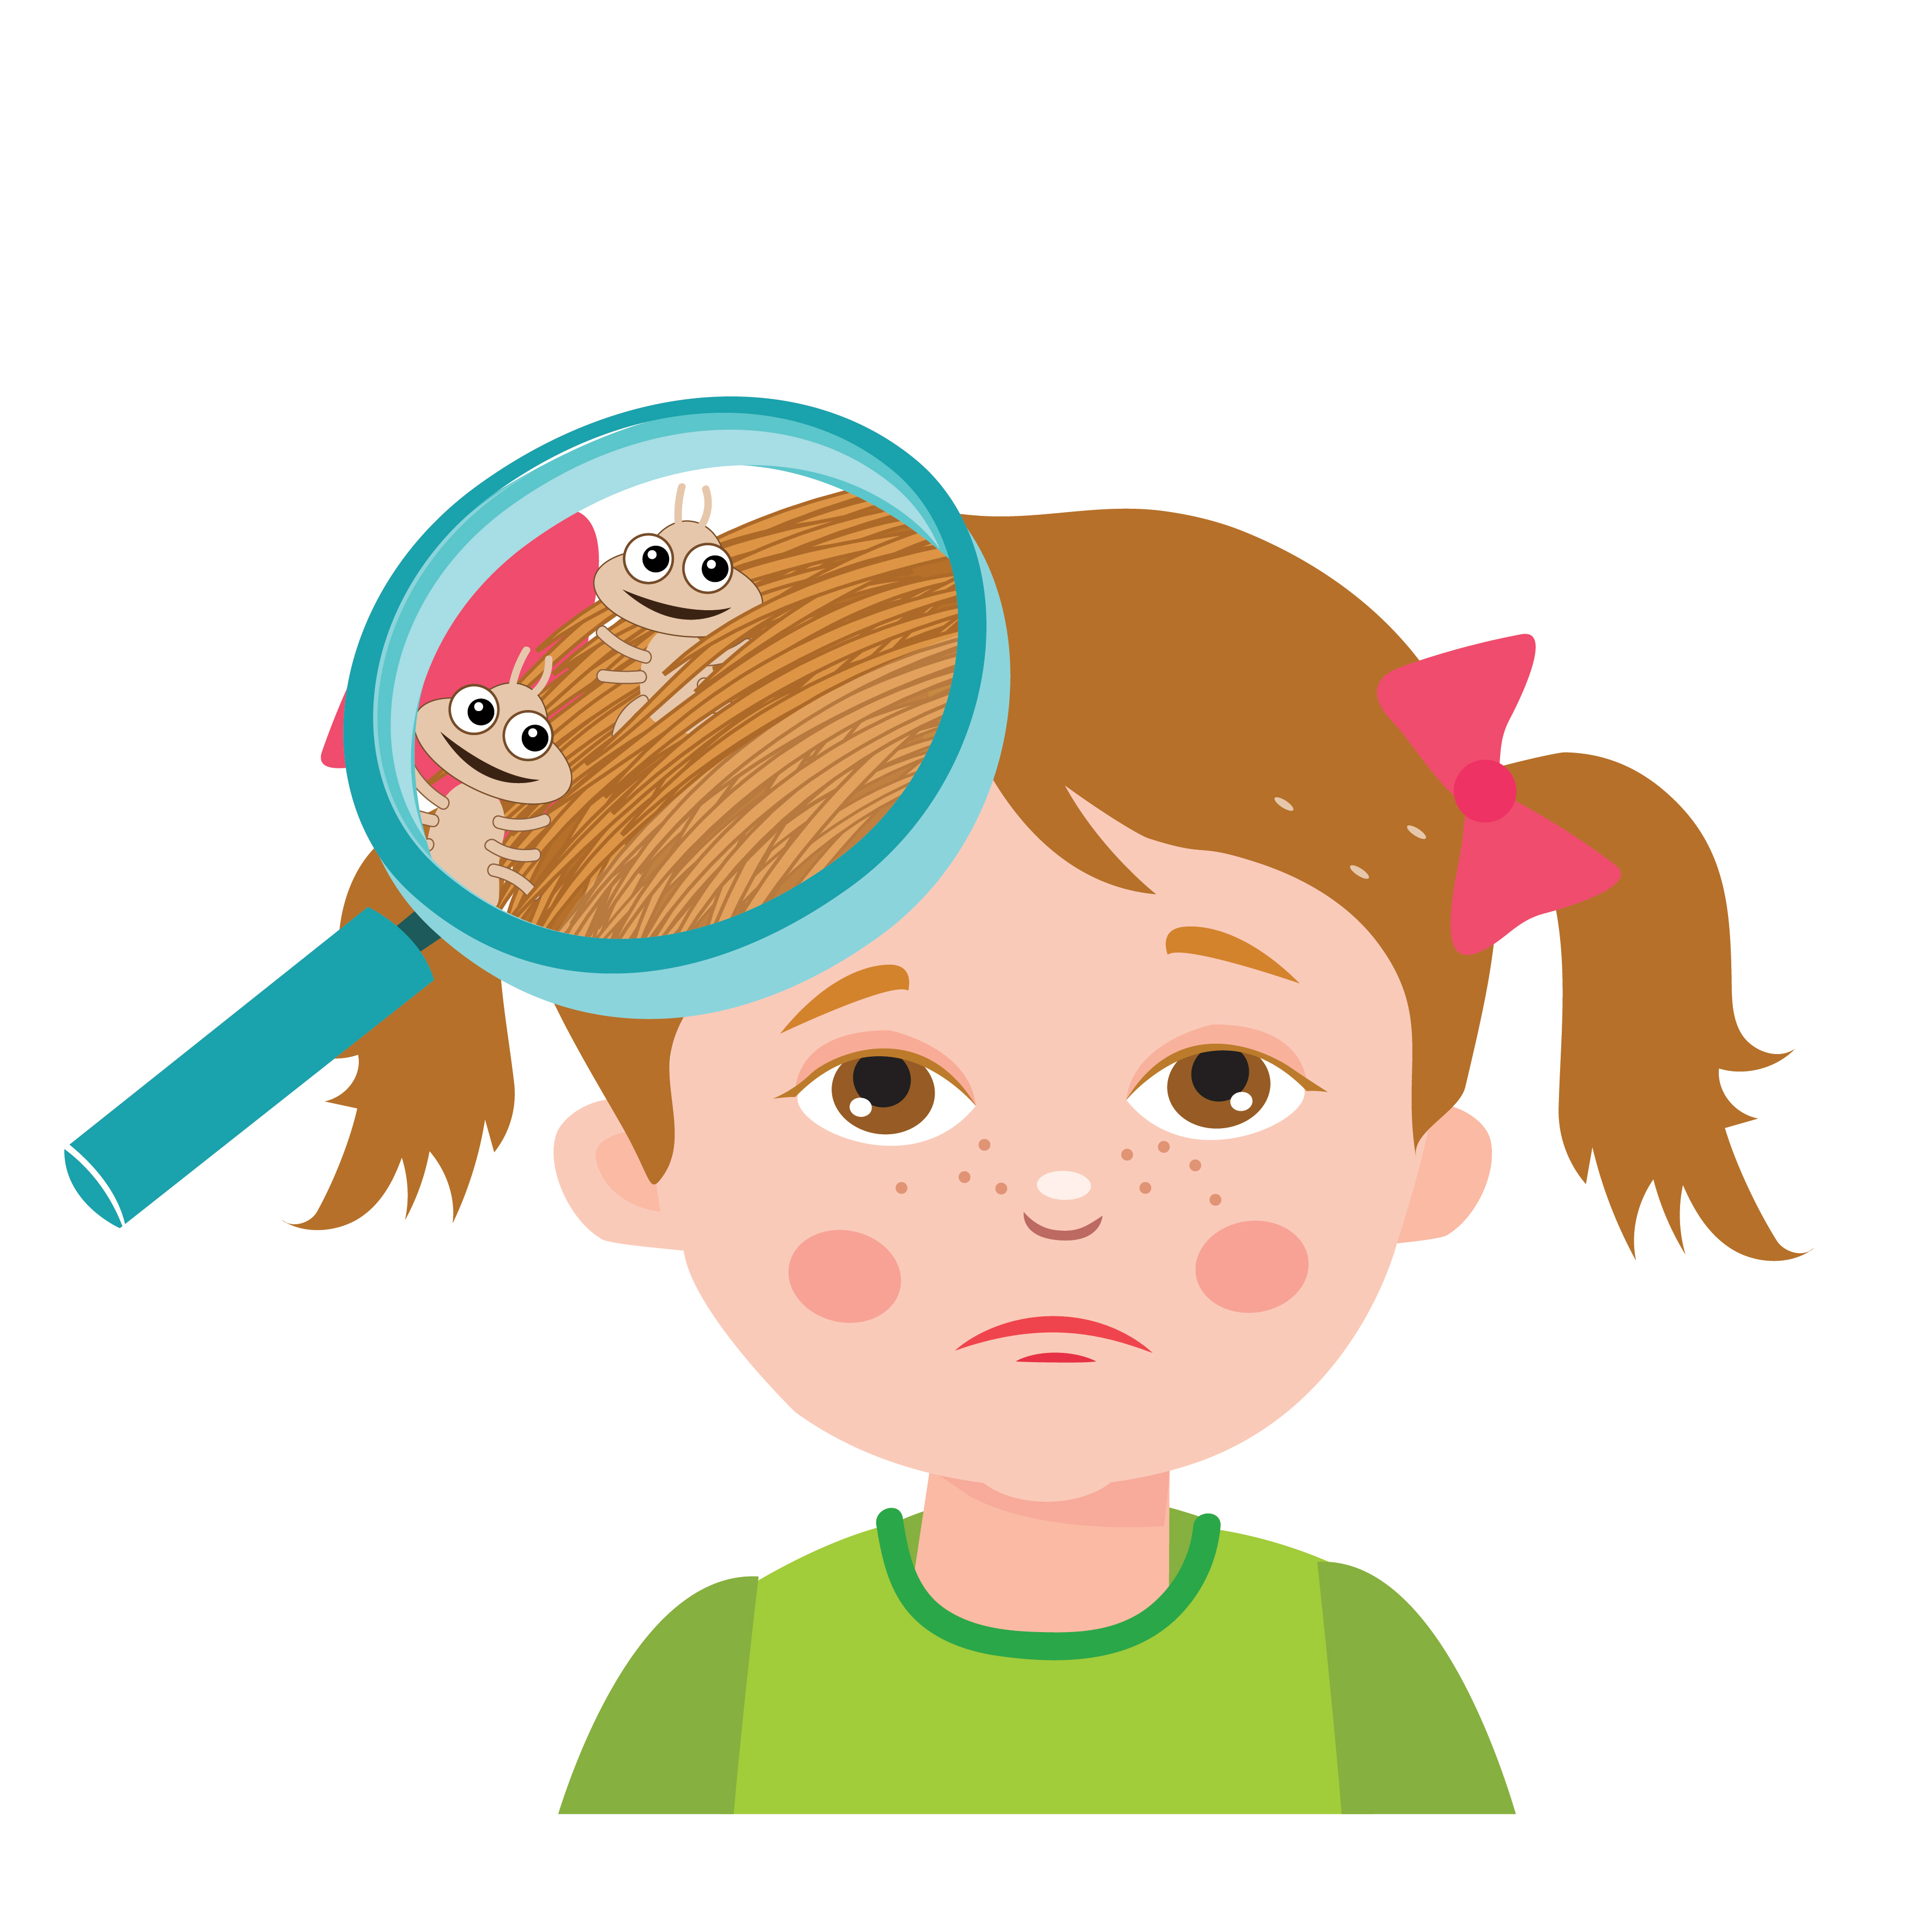
Signs/Symptoms
Tickling feeling of something moving in hair
Itching (caused by allergic reaction to the bites of the lice)
Irritable/problems sleeping (lice are more active in the dark)
Sores on the head from scratching

Slide 12
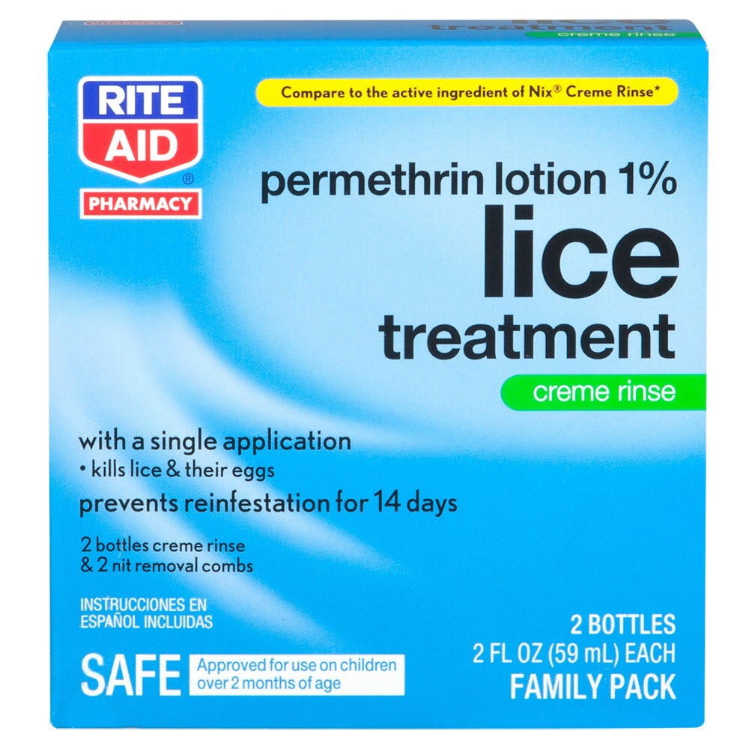
Treatment Basics
Over the counter or prescription medication only!
All household members should be checked
Retreatment before new eggs are produced (7-9 days after first treatment depending on which medication is used)
Follow directions on medication box or printed label for how to use specific product

Slide 13
Treating Your Child
Remove clothing that could become wet/stained before treatment
Apply treatment according to medication instructions on box or printed label
Look at how long the medication should stay in the hair before rinsing and how it should be rinsed
Warning: do not use conditioner before lice treatment. Do not re-wash hair for 1-2 days after medicine is removed

Slide 14
Treating Your Child
Have child put on clean clothing after treatment
Do not retreat if the lice are still there but moving slower. Some treatments take longer than others
Comb dead and remaining live lice using a fine-toothed nit comb
If after 8-12 hours, the lice are still alive and active, call provider FIRST before retreating. You may need a different medication.
Continue to use nit comb to remove nits for 2-3 weeks after treatment

Slide 15
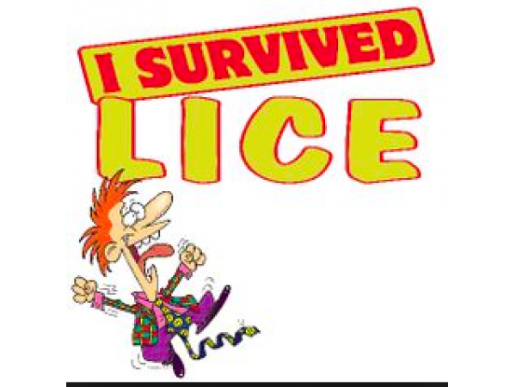
Treating Your Child
Do not use extra amounts of medication unless told by your doctor
Always get your doctors advice first if a treatment appears to not be working
Do not use different medications at the same time unless told by your doctor to do so

Slide 16
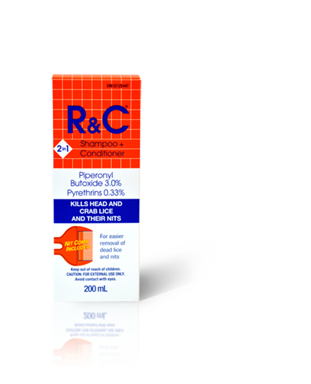
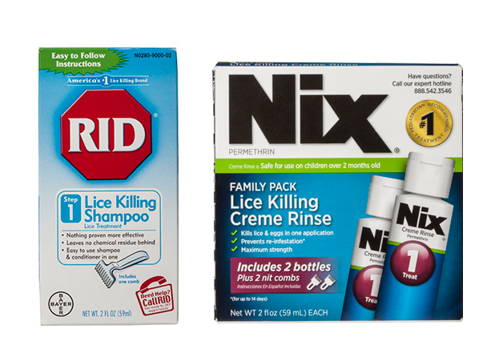
Over-the-Counter Medications
Pyrethrins Brand: A-200, Pronto, R&C, Triple X, RID
Permethrin lotion (1%) Brand: Nix
*Approved by US FDA

Slide 17
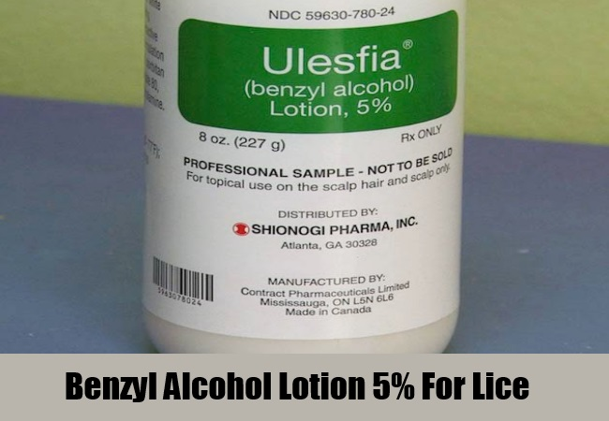
Prescription Medications
Benzyl alcohol lotion (5%) Brand: Ulesfia lotion
Ivermectin lotion (0.5%) Brand: Sklice
Spinosad topical suspension (0.9%) Brand: Natroba
*Approved by US FDA

Slide 18
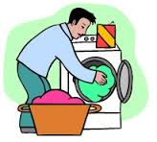
Cleaning Your Home
You don’t have to spend a lot of time and money on cleaning your home
Lice survive off the human scalp for less than 1-2 days so your home will be fine
Machine wash and dry clothing, bed linens, and other infested items at 130 degrees F and hot heat drying cycle
Can seal items in plastic bag for two weeks if not washable

Slide 19
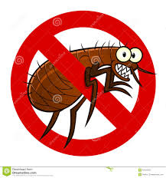
Cleaning Your Home
Vacuum floor and furniture… head lice do not survive for more than 1-2 days so don’t worry too much about this
Do not use fumigant sprays- these can be toxic if inhaled or absorbed into the skin
Soak combs/brushes in hot water (130 degrees F) for 5-10 min

Slide 20
References
https://www.ndhealth.gov/head-lice/publications/myths_and_facts.pdf
https://www.cdc.gov/parasites/lice/head/treatment.html
https://www.cdc.gov/parasites/lice/head/parents.html
https://www.cdc.gov/parasites/lice/head/gen_info/faqs.html

