Slide 1
Welcome!

Slide 2

Financial Aid Basics
Financial Aid: funds to help students pay the cost of an education at a post-secondary school.
Keep in mind:
Eligibility criteria may apply in order to receive/maintain financial aid
  Students must maintain satisfactory academic progress
  Additional criteria may be required based on the type and source of aid
Students should play an active role in the process
  Talk with children about goals/plans (review educationplanner.org & collegecost.ed.gov)
  Take advantage of college fairs & school visits (ask about cost and available aid)
Some students may not qualify for all forms of aid
Must apply every year to be considered

Slide 3

Financial Aid Basics
Cost of Attendance(COA):
Costs that the student can expect to incur during a specific school year
Direct costs: billed by the school
Indirect costs: not included in bill but may be incurred
Student Aid Index (SAI)
Used to determine eligibility for need-based aid.
Based on federal formula using information collected from the Free Application From Federal Student Aid (FAFSA)
School costs include:
  Tuition and fees
  Housing & Food
  Books and supplies
  Transportation
  Living expenses
  Childcare, if necessary
Financial Need
Schools will determine need after reviewing financial aid applications
Schools determine aid based on need, eligibility & available funding at their schools

Slide 4
Types of Financial Aid
Page 14; PA Student Aid Guide
GIFT AID: Free Money
  Scholarships: based on merit, unique characteristics and/or need
  Grants: usually based on financial need
SELF HELP AID: Loans, Work Programs, Savings
  Work Study: Student obtains job, often coordinated through the campus and/or State.
    wages earned help cover cost of attendance
    Not offered at all school
  Loans: Borrowed money that must be repaid
Additional sources: 529 plans, tuition payment plans, savings, etc.

Slide 5
Sources of Aid
Federal Government (studentaid.gov)
State Government (pheaa.org)
School or College
Scholarship Organizations

Slide 6
Scholarship Tips
Start early and search often
National, Local & Regional and Postsecondary scholarships
Use FREE scholarship search sites
Don’t ignore scholarships with
smaller award amounts
Search for scholarships every year
Pay attention to deadlines!
Listen to our Searching for Scholarships webinar from September 18, 2023, for more scholarship tips.
  Pheaa.org/virtual ( scroll to bottom and click on “ check out our previously recorded webinar events)
FastWeb.com
Www.sacfoundation.com
Www.tfec.org
Chegg.com
FinAid.org
ScholarshipExperts.com
Scholarships.com
Scholarship-Page.com
DoSomething.org/Scholarships
Colleges.Niche.com
StudentScholarships.org
BigFuture.Collegeboard.org
CollegeAnswer.com
CollegeNet.com
MeritAid.com
MORE….

Slide 7
Federal Student Aid Programs
MUST SUBMIT FAFSA FORM
Additional details: Studentaid.gov & SAG p11
Federal Program | Program Details | Annual Max Award *
Pell Grant | Awarded to undergraduate students who demonstrate financial need | $7,395
Federal Supplemental Educational Opportunity Grant | Awarded to undergraduate students who demonstrate exceptional financial need | $4,000
Federal Work-Study | Provides jobs for students with financial need, to earn money to help pay school expenses | Determined by School
TEACH | For students who are enrolled in programs designed to prepare them to teach in a high-need field at the elementary or secondary school level | $3,772
Direct Loan | Federal student loan to help cover school expenses (must be repaid) | Ranges from $5,500 to $12,500 per year
Direct PLUS Loan | Federal parent student loan to help cover school expenses (must be repaid) | Up to max school costs minus other aid received
*Max award amounts reviewed annually
Notes:
Max EFC for 23-24 AY = $6,656.

Slide 8
Pennsylvania State Grant
MUST SUBMIT FAFSA & PA STATE GRANT FORMS
Student Aid Guide- pgs. 7-8
PA State Grant: 2023-24 max award $5,750
Awarded to eligible PA residents who demonstrate financial need
Required: approved school/ approved program of study
Out of State schools in DE, MA, OH, WV, VT & DC: max $600
  Veterans: up to $800
Cost Tier | Minimum Award | Maximum Award
$0 - $12,000 | $500 | $3,059
$12,001 - $19,000 | $500 | $4,894
$19,001 - $29,000 | $500 | $5,261
$29,001 - $32,000 | $500 | $5,750

Slide 9
PA State Administered Programs
PA Blind or Deaf Higher Education Beneficiary Grant
Chafee Education and Training Grant Program– co-administered with the PA Department of Human Services
PA Fostering Independence Tuition Waiver Program (FosterEd)
PA National Guard Educational Assistance Grant (EAP)
PA National Guard Military Family Education Program (MFEP)
PA Postsecondary Educational Gratuity Program (PEGP)
PA Partnerships for Access to Higher Education (PATH)
PA State Work-Study - job related to major
PA Student Loan Relief for Nurses (SLRN) Program
PA Targeted Industry Program (PA –TIP)
PA Ready to Succeed Scholarship (RTSS)

Slide 10

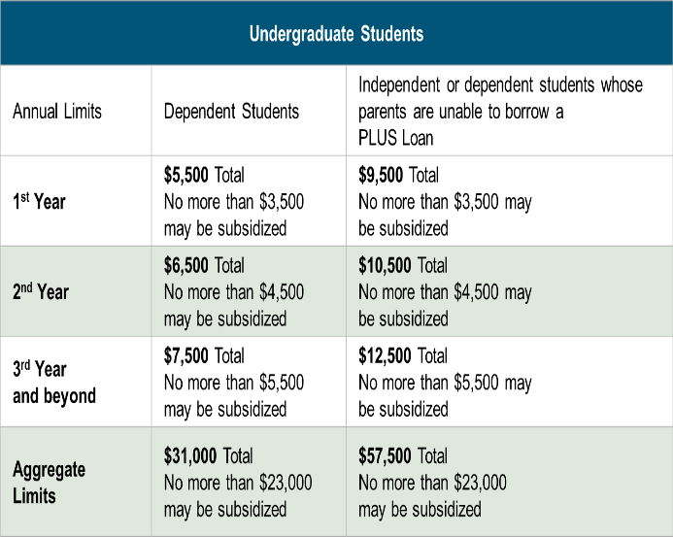
Federal Direct Loans
Loan is in student’s name
Max. borrowing limits
May receive a Direct Subsidized and/or Direct Unsubsidized loan
Fixed rate: set July 1st for 1st time borrowers
Origination fee
Deferred payments
Must complete the FAFSA
Must complete entrance counseling & MPN
Notes:
4.99 & 1.057
7.54 & 4.228

Slide 11

Additional Student Loans
Federal PLUS Loans
Private Loans
Loan is in the parent’s name
Must meet credit requirements
  May apply with a credit worthy cosigner
  If denied, student may borrow additional unsubsidized amount
May borrower up to the COA minus any other aid
Fixed interest rate: set July 1 for 1st time borrowers
Origination fee
Payments may be deferred
Student must complete the FAFSA
Loan is in the student’s name (cosigner is generally required)
Student or Cosigner must meet income & credit requirements
May borrower up to the COA minus any other aid
Variable or fixed interest rate
May have cosigner release clauses
Terms vary by lender
  Do your research
  Read the fine print

Slide 12

PA’s Low-Cost Way
to Pay for College!
Low, Fixed Rates
Learn more at PHEAA.org/PAForward
1) Annual Percentage Rate (APR) Calculations – The lowest APR is based on the following assumptions: a loan of $10,000 made in a single disbursement, a student borrower who selected an Immediate Repayment Plan and a repayment term of 120 months, monthly payments of $100.87 and a final payment $78.29, a fixed periodic interest rate of 4.17%, and a total amount financed of $11,980.40. The student borrower in this sample qualified for a 0.25% Direct Debit benefit for the entirety of the repayment period and a 0.50% graduation benefit was applied 47 months into repayment. The highest APR is based on the following assumptions: a loan of $10,000 made in a single disbursement, a student borrower who selected a Fully Deferred Repayment Plan and a repayment term of 180 months, monthly payments of $117.93, a fixed periodic interest rate of 7.07%, and a total amount financed of $21,227.72. The student borrower received an in-school deferment of 46 months and a grace period of 6 months. The student borrower in this sample did not qualify for any interest rate discounts. These APRs are estimates and may differ from the actual rates received.
2) The provided rate range includes Undergraduate, Graduate, and Parent loans and may change based on loan type, loan term, repayment plan, and applicable discounts (not all discounts apply to all loan products). See individual loan programs for more specific information. PHEAA uses applicant credit scores to determine eligibility and interest rates. Higher credit scores may mean an applicant is offered a lower interest rate.
Applicants, including co-signers, are subject to credit qualifications, completion of an application and credit agreement, and verification of application information. PHEAA uses applicant(s) FICO score(s) to determine eligibility and interest rates. Higher credit scores may mean an applicant is offered a lower interest rate.
PHEAA reserves the right to discontinue all programs or benefits without prior notice.

Slide 13

Be a Smart Borrower
Exhaust all free financial aid options before borrowing student loans
Seek federal student loans before private student loans
Only borrower the amount needed (loans must be repaid)
Do your research!
MySmartBorrowing.org: An interactive, online tool created by PHEAA that helps students and families:
  Estimate career, salaries & college tuition
  View the impact of savings on overall cost
  Calculate loan repayment
  Avoid borrowing too much money
Select a
Career
Factor in Savings
Select a School
Get Results

Slide 14
The Application Process

Slide 15

Financial Aid Forms
Know which forms are required by each school
All Schools Require:
Free Application for Federal Student Aid (FAFSA)
    Required by PHEAA, and some scholarship organizations as well
PA State Grant Form (SGF) through PHEAA
    Required for first -year students
    Link from the FAFSA form or apply at www.pheaa.org
Some Schools Require:
CSS Profile (College Scholarship Service)
  https://student.collegeboard.org/css-financial-aid-profile
Institutional Financial Aid Forms
  Internal forms specific to each school
  Required by some schools for institutional aid

Slide 16
Know Your Deadlines
Admission applications
Scholarship applications
Federal, State & school deadlines exist
PA State Grant Deadlines for FAFSA
  May 1, 2024 – First-time and renewal students attending colleges, universities & college transferrable programs (excluding community colleges)
  August 1, 2024 – First-time students attending community college; a business, trade or technical schools, hospital school of nursing; Open Admissions Institutions or a 2-year non-transferrable degree program at a Jr or 4-year college.
File the FAFSA by the earliest deadline

Slide 17
Free Application for Federal Student Aid: FAFSA
Important!
All students who wish to be considered for financial aid & plan to attend an approved post-secondary school must complete the form.
Complete the correct FAFSA (2024-25 AY)
Provide answers based on the day the form is filed (except tax/income information)
Enrollment Dates (year student will attend college or career school) | When can students submit the FAFSA | Tax Return Information
July 1, 2023 - June 30, 2024 | October 1, 2022 – June 30, 2024 | 2021
July 1, 2024 - June 30, 2025 | December 2023 – June 30, 2025 | 2022
July 1, 2025 - June 30, 2026 | October 1, 2024 – June 30, 2026 | 2023

Slide 18

Information Needed for 2024-25 FAFSA
Student Aid Guide- p. 18
Social Security Numbers
Email Addresses
(high school email address not recommended)
2022 Federal Tax Returns
Current bank statements and records of other investment accounts (as of the FAFSA filing date including farm value and value of small business)
Student & Contributor(s)
Federal Student Aid
Account FSA ID
Current Records of any stocks, bonds and other investments, including 529 for student for whom the FAFSA is being completed
Total child support received from the most recently complete calendar year

Slide 19

Federal Student Aid Accounts (FSA ID)
Information Needed for 2024-25 FAFSA
Social Security Number
Username
Email Address
Password
Mobile Phone
Security Questions
Enable Two-Step Verification
The student applying and all required contributors to the FAFSA must create an FSA ID.
Create account at FSA ID at studentaid.gov/fsa-id.
Create 3 - 4 days prior to completing the FAFSA.
Legal signature on FAFSA & PA State Grant forms.
Requires a valid email account for each user
Users without an SSN will be able to acquire an FSA ID

Slide 20
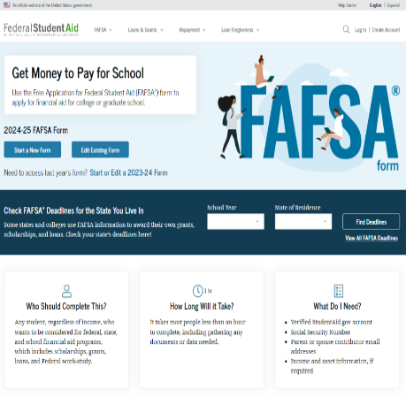
Free Application for Federal Student Aid (FAFSA®)
File online at studentaid.gov
2024-25 FAFSA® is New & Improved!
New redesigned form available December 2023
Student & required contributors (parents) must:
  Provide consent for FSA to retrieve & disclose federal tax information
  Log in with their own FSA IDs to complete their respective sections
For an estimate of federal aid visit: Studentaid.gov/aid-estimator
Free to file

Slide 21

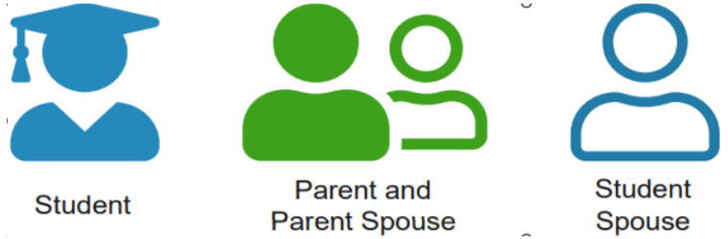
Roles Within the 2024-25 FAFSA
Answers on FAFSA determine which contributors will be required to provide information
Student invites contributor(s) to complete their portion of the form
  Required: Name, date of birth, SSN and email address
Contributors are not financially responsible for student’s education costs

Slide 22
FAFSA Steps
Personal Circumstances
Demographics
Financials
Colleges
Signature
5 key sections on the 24-25 FAFSA
Collects key data regarding demographic & financial information
Onboarding steps, wizards and help tools to guide students & contributors
Student completes all sections
Contributors (parents) completes (demographics, financials & signature)
Form is not complete until all required signatures are submitted

Slide 23
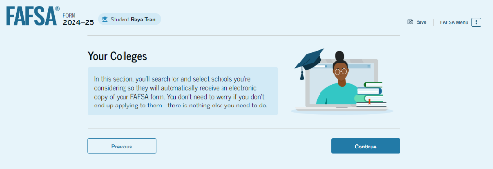
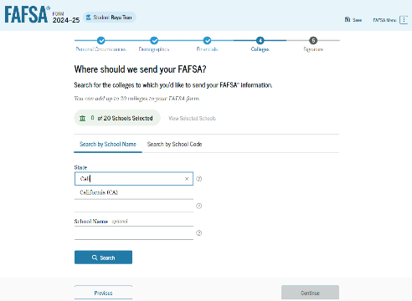
FAFSA – Colleges Section
  Only schools listed will receive results of FAFSA
  Don’t have to have applied/been accepted to list school
  Can list up to 20 schools at a time
  May go back and add schools later
NOTE: Once your Final Decision is made, Update your PA Grant Information with the school you WILL attend.

Slide 24
Whose Information is reported on the 2024-25 FAFSA?
Dependent student & legal parent(s)
  Biological/adoptive parents living together (married/unmarried)
  Divorced or separated parents
    The parent that provided the most financial support to student over the past 12 months (if remarried, spouse)
    If equal, the parent with the higher income
Independent student- student’s information only (and spouse, if married)
Do NOT include:
Foster Parents
Legal Guardians
  By court order
Anyone else living with the student

Slide 25

Who Is Independent?
Born before January 1, 2001
Married (and not separated)
Veteran (includes active-duty personnel)
Working on graduate level degree
Parent’s information is not required
Emancipated minor
Legal guardianship
Anytime since the age of 13 has been either:
  An orphan,
  In foster care
  Ward of the court
Have legal dependents other than spouse
Student unaccompanied and homeless or self-supporting and at risk of being homeless

Slide 26

Financial Information:
Income: 2022 Income information is required for the 2024-25 FAFSA form. After consent is provided:
  The IRS Direct Data Exchange (DDX) transfers Federal Tax Information (FTI) or
  Confirm non-filing status (if not required to file taxes)
DDX may not work and FTI needs entered manually if the student or parent:
Had a change in marital status since filing their tax return
Filed a Puerto Rican or foreign tax return.
Was victim of identity theft

Slide 27
Financial Information:
Student Aid Guide- p. 18
Assets: Some will not be required to report assets
If required to report assets:
Do not report the value of:
  Primary home
  Qualified retirement funds
  Life insurance policies
Report the net value of assets, as of the day you are completing the FAFSA.
  Balance of checking & savings accounts, records of stocks, bonds, bitcoins, etc.
  Value of 529 accounts for the student owned by the parent(s) of a dependent applicant or owned by the student applicant
  Child support received for the most recently completed calendar year
  Net Worth of your businesses or
  For-profit agricultural operations (subtract the value of primary home if it is on the farm)

Slide 28
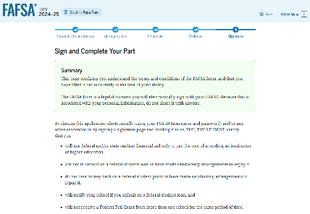
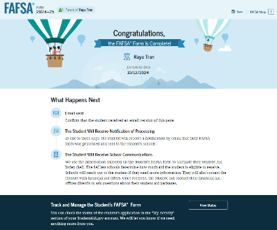
Signing with the FSA ID
FAFSA must be signed by Student & all required contributors before it is considered complete.
If parent submits the FAFSA, then student will receive an email and can access the detailed confirmation page.

Slide 29

Special and Unusual Circumstances
Special Circumstances
Unusual Circumstances
If financial situation changes...
Loss of employment or financial assets
Reduced income
Tuition expenses at a secondary school
Unusual medical or dental expenses not covered by insurance
-Contact schools listed on FAFSA
-Contact PHEAA for the PA State grant
If student is unable to provide parent information due to unusual circumstances:
Human trafficking
Legally granted refugee or asylum status
Parental abandonment or estrangement
Student or parental incarceration
- Follow Provisional Independent Status on FAFSA form

Slide 30

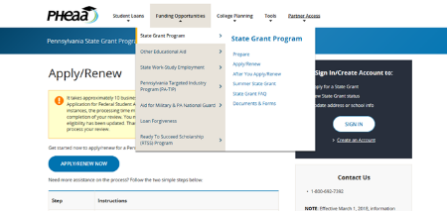
PA State Grant Form & PHEAA Access
Don’t forget to complete the PA State Grant form:
Link off the FAFSA Application Confirmation Page or
Create an account at pheaa.org to:
  Complete State Grant Form, if you missed the link at the end of the FAFSA
  Check your PA State Grant eligibility
  Update your school of choice listed on the PA State Grant Form

Slide 31
Forms are Filed – Now What?

Slide 32

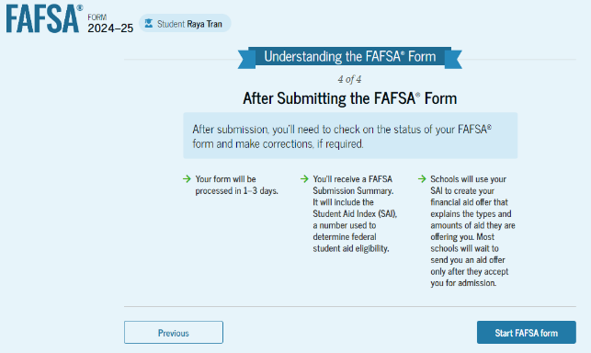
The Process Continues
After the FAFSA is filed:
Monitor emails & respond to requests from Federal Student Aid, PHEAA & schools.
Student receives FAFSA Submission Summary
Student Aid Index (SAI) is included on the FAFSA Submission Summary
  Schools use SAI to create financial aid offers
FAFSA describes next steps

Slide 33

Need Analysis
Cost of Attendance ………………….....,,,,.....… $29,000
  - Student Aid Index (SAI)…….………….…... - $4,000
  Other Financial Aid (OFA)........................ -$3, 000
  = FINANCIAL NEED ………………......... = $22,000
FAO “awards” students based on financial need and available funding (varies by school)
Financial Aid Notification is sent to the student after they have applied & been accepted.
  Lists types, sources and amount of aid
  Describes what must be done to accept or reject
  Review carefully!
Cost of Attendance
- EFC
= Financial Need

Slide 34
Compare & Understand Financial Aid Offers
Do you understand your actual costs?
  Cost of Attendance
  Out of pocket costs
  Do you have other children’s education costs to consider?
Have you made an affordable choice of school?
Students and parents should talk about what they can afford to pay.
Do you understand your aid offers?
How much of the financial aid is free money?
Which awards are based on need, and which are based on merit?
Are there any conditions on the free money? GPA requirement?
Will awards increase as tuition increases?
Will awards change from year to year?
Will loans be needed?

Slide 35
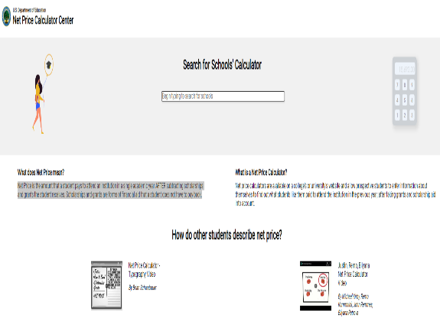
Net Price
Net Price is the amount that a student pays to attend an institution in a single academic year AFTER subtracting scholarships and grants the student receives.
Net Price Calculators
Available at collegecost.ed.gov/net-price
All schools must have a net price calculator on their school’s website

Slide 36
What Can You Do Now?
Research & visit schools/Websites
Continue to Explore Scholarships
Estimate Federal Student Aid
studentaid.gov/aid-estimator
Utilize Net Price Calculators
collegecost.ed.gov
Explore Scholarships
Create FSA ID & Complete the FAFSA
Talk About What is Affordable

Slide 37


Resources
Federal Student Aid Information Center
  Email, call or chat with customer service agents
  Phone: 800-433-3242 (800-4-FED AID)
  Websites: Studentaid.gov & collegecost.ed.gov
PHEAA
  Email: granthelp@pheaa.org
  Phone: 800-692.7392
  Website: PHEAA.org
    MySmartBorrowing.org
    Educationplanner.org
Financial Aid Offices

Slide 38
Resources
Higher Education Access Corner
Higher Education Access Corner provides candid conversations around higher education access and affordability. Tune in to hear a variety of engaging discussions with industry professionals, as well as how PHEAA helps create affordable access to higher education.
Subscribe and listen on your favorite podcast app or streaming platform.
Available on Spotify, Google Podcasts, iHeartRadio, Amazon Music and more
Available on PHEAA’s YouTube channel (PHEAA Financial Aid).

Slide 39

PHEAA Statewide Webinars
Searching for Scholarships: September 18, 2023, 6-7 PM
Description: The cost of a postsecondary education can add up quickly for students and families. Thankfully, there is funding to help cover those expenses. Join us as we share tips to help students successfully search and apply for scholarships. After attending this webinar, students will understand the different types of scholarships, resources for finding scholarships, and tools to help increase their chances of earning those scholarships.
Creating your Federal Student Aid Account (FSA ID): November 14, 2023, 6-6:30 PM
Description: The cost of a postsecondary education can add up quickly for students and families. Thankfully, there is funding to help cover those expenses. Join us as we share tips to help students successfully search and apply for scholarships. After attending this webinar, students will understand the different types of scholarships, resources for finding scholarships, and tools to help increase their chances of earning those scholarships.
Financial Aid 101: December 13, 2023, 6-7 PM
Description: The cost of a postsecondary education can add up quickly for students and families. Thankfully, there is funding to help cover those expenses. Join us as we share tips to help students successfully search and apply for scholarships. After attending this webinar, students will understand the different types of scholarships, resources for finding scholarships, and tools to help increase their chances of earning those scholarships.
pheaa.org/virtual

Slide 40
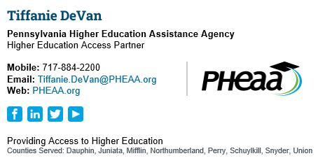
QUESTIONS?

